Slide 1
Variations and Mutations instead of PPT USE BIOLPGY STUDY GUIDE

Slide 2
Lesson Objectives
At the end of this lesson you should be able to
Identify two causes of variation
Identify the characteristics of mutant alleles
Identify two types of mutations
Give an example of each type
List two agents responsible for increased mutation rates

Slide 3
Chromosomes and Genetics
Chromosomes are long pieces of DNA, with supporting proteins
Genes are short regions of this DNA that hold the information needed to build and maintain the body
Genes have fixed locations: each gene is in a particular place on a particular chromosome
Diploids have 2 copies of each chromosome, one from each parent. This means 2 copies of each gene.

Slide 4
Human Chromosomes
We have 46 chromosomes, or 23 pairs.
44 of them are called autosomes and are numbered 1 through 22. Chromosome 1 is the longest, 22 is the shortest.
The other 2 chromosomes are the sex chromosomes: the X chromosome and the Y chromosome.
Males have and X and a Y; females have 2 X’s: XY vs. XX.

Slide 5
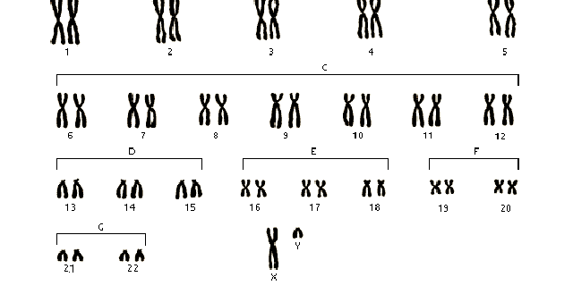
Male Karyotype

Slide 6
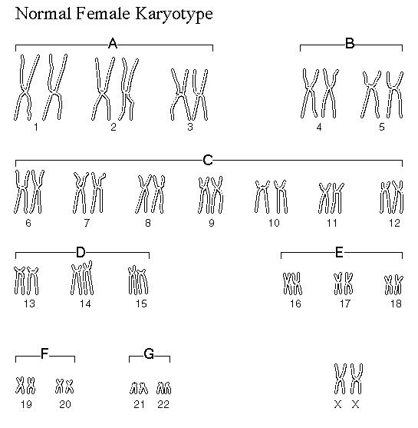
Female Karyotype

Slide 7
Sex Determination
The basic rule:
If the Y chromosome is present, the person is male.
If absent, the person is female.

Slide 8
Learning Check
What is the difference between a chromosome and a gene?
What is the difference between the terms haploid and diploid?
How many pairs of chromosomes do we have?
What are pair number 23 called?
What is the difference between the male and the female karyotype?

Slide 9
Meiosis
the X and Y chromosomes separate and go into different sperm cells:
½ the sperm carry the X and the other half carry the Y.
All eggs have one of the mother’s X chromosomes
The Y chromosome has the main sex-determining gene on it, called SRY

Slide 10
Sex Determination
About 4 weeks after fertilization, an embryo that contains the SRY gene develops testes, the primary male sex organ.
The testes secrete the hormone testosterone.
Testosterone signals the other cells of the embryo to develop in the male pattern.

Slide 11
Causes of Inherited Variations
Sexual reproduction
The independent assortment of chromosomes when gametes are being formed
Crossing Over during Meiosis – this allows genes to move between chromosomes
Mutations

Slide 12
Fact
When your parents cells undergo meiosis to produce sperm/egg cells
8 million different combinations of their chromosomes are possible
Every zygote is a 1 in 64,000,000,000,000
combination of chromosomes!
This leads to great variation in species

Slide 13
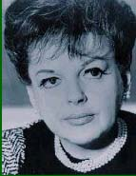
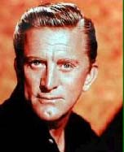

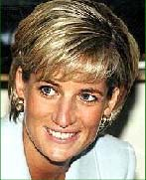
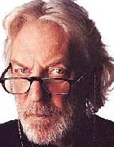
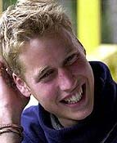

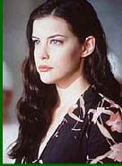
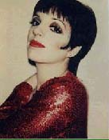
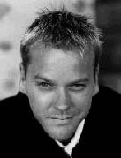
Whose Child?

Slide 14
Whose Child?

Slide 15
Differences between parents and offspring
Offspring are similar to their parents but are not identical
Cause – crossing over

Slide 16
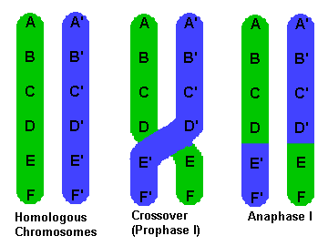
Crossing Over

Slide 17
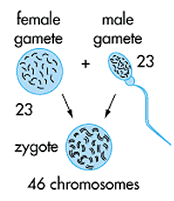
Fusion of gametes
Sperm and egg cell fuse to form a zygote
The combination of chromosomes leads to great variation in species

Slide 18
Learning Check
What happens during meiosis?
What does meiosis lead to?
What are the causes of variation?
Why are offspring not identical to their parents?

Slide 19
Chromosome Number Variations
Except for the X and Y, humans don’t survive with only 1 copy of any chromosome. Also, 3 copies is lethal in most cases.
Down Syndrome is the most common human aneuploidy. It is also called trisomy-21, meaning 3 copies of chromosome number 21.

Slide 20
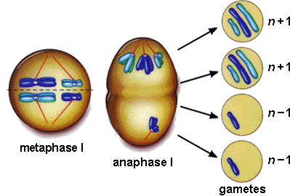
Aneuploidy

Slide 21
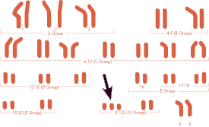
Downs syndrome

Slide 22
Chromosome Structure Variations
Chromosomes can be broken by X-rays and by certain chemicals.
The broken ends spontaneously rejoin, but if there are multiple breaks, the ends join at random.
This leads to alterations in chromosome structure.

Slide 23
Structure Variation Examples
There are lots of ways chromosomes can change structure, so the syndromes are not as well defined as with number variations.

Slide 24
Point mutations
These are changes in just one base pair of a gene.
If a point mutation occurs in a gamete or in a cell that gives rise to gametes, it may be transmitted to offspring and to a succession of future generations e.g. sickle cell anaemia.
© Biology Support Service 2007

Slide 25
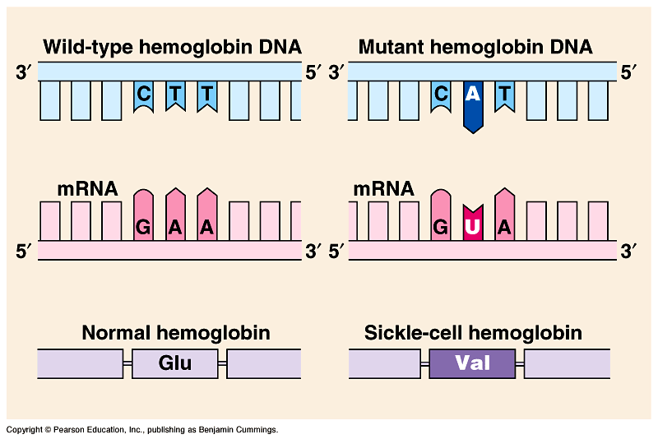
Sickle Cell Anaemia is caused by a point mutation-
A mutation of a single base pair in the gene that codes for one of the polypeptides of haemoglobin.

Slide 26
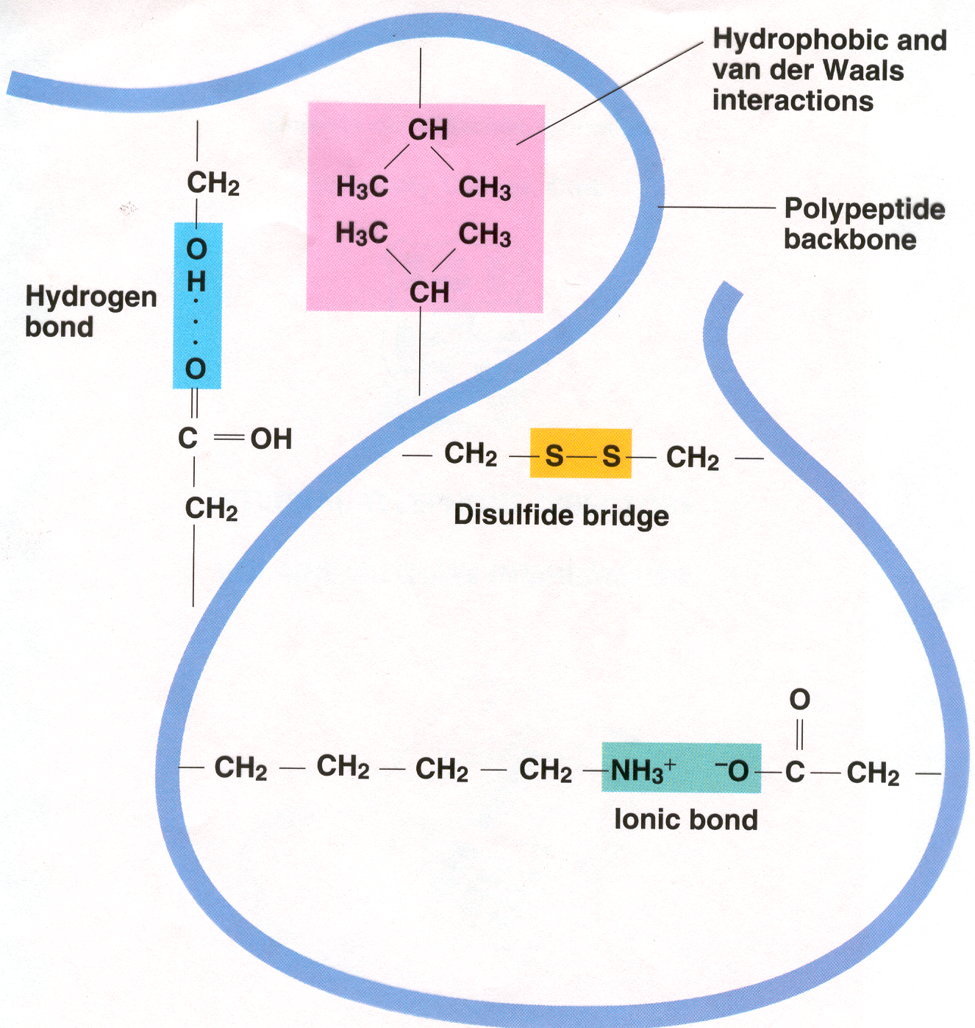
Protein folding
Campbell and Reece (2002) Biology
Just one amino acid could affect how a protein folds
© Biology Support Service 2007

Slide 27

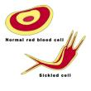
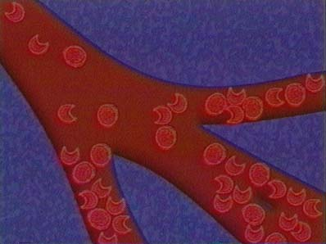
As a result, damage is caused to the red blood cell membrane, resulting in a cellular lifespan of only a few days. Due to the sickle cell shape, small capillaries may become blocked.
ww.sciencemuseum.org.uk/genes/223.asp
www.cnn.com/sickle/cells.lage.jpg
www.pueblo.gsa.gov/sicklecell/496-sick.html

Slide 28
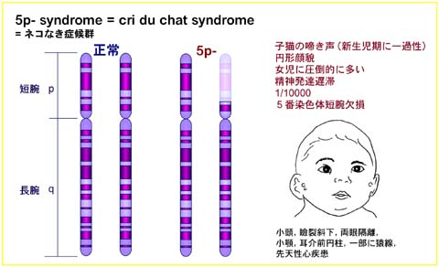
Cri Du Chat Syndrome
Cri-du-chat syndrome comes from a deletion of one end of chromosome 5, so the person only has 1 copy of all the genes on this end of the chromosome.
Missing part of Chromosome 5

Slide 29
Mutations – Other Causes
Radiation High energy radiation from a radioactive material or from X-rays
These X rays attack the DNA molecule and alters it in many ways.
Radiation can also cause double strand breaks in the DNA molecule, which the cell's repair mechanisms cannot put right
Remember Chernobyl

Slide 30
Dying for a Suntan
Sunlight contains UV radiation (the component that causes a suntan)
This can cause an abnormal cross link in DNA to form between certain adjacent bases.
In most normal cases the cells can repair this damage, but sometimes a mutation can occur
Unprotected exposure to UV radiation by the human skin can lead to skin cancer and extensive skin tumors.

Slide 31
Smoking
A chemical in cigarette smoke causes mutations in a crucial gene associated with cancer.
Cigarette smoke caused mutations in a gene called P53.

Slide 32
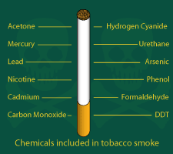

Slide 33
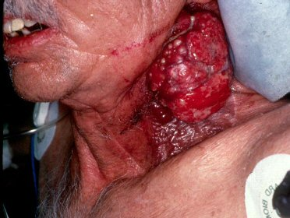

Slide 34
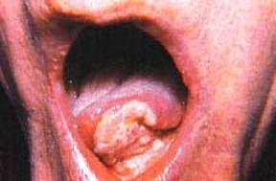

Slide 35
Learning Check
What is meant by aneuploidy?
Give an example?
What are the causes of structural variation in chromosomes?
Give an example of a structural variation?
What are the causes of mutatoins?

Slide 36
What have you learned?
Can you ………………
Define variation and mutation
List the causes of variations and mutations
List the types of mutations
Discuss the causes for and effects of increased mutation rates

Slide 37
End

